Slide 1
DIGITAL PORTFOLIO
NAME :SWATHY.B
REGISTER NO :24131210500122046
DEPARTMENT :2nd BCA
COLLEGE :IMMACULATE COLLEGE FOR
WOMEN
NAAN MUDHALVAN ID:asanm121anm12124213046

Slide 2
PROJECT TITLE
STUDENT PORTFOLIO

Slide 3
AGENDA
1.Problem Statement
2.Project Overview
3.End users
4.Tools and Technolgis
5.Portfolio Design and Layout
6.Features and Functionality
7.Results and Screenshots
8.Conculsion
9.GitHub Link

Slide 4
PROBLEM STATEMENT
Provides backgroud information on the problem,including what is currently known.
Clearly states the specific problem or challenge the project will address.
Explain why this problem is important,its impact on users or stakeholders,and the value of finding a solution.

Slide 5
PROJECT OVERVIEW
It ensures everyone,from the project team to senior management and clients,understabds the project’s purpose and goals.
It serves as a central reference point throughout the project,keeping the team focused on the overall vision.

Slide 6
END USERS
They are the individuals who directly operate the technology,applying its features and functions.
They use product or service to fullfill a specific task or need.
An employee using a word processor,or a customer using a banking app on their smartphone.

Slide 7
TOOLS AND TECHNOLOGIES
Microsoft office
Google workspace
slack

Slide 8
PORTFOLIO DESIGN AND LAYOUT
Make it easy for visitors to find what they are looking for.
Use a clean and simple design:Avoid clutter and focus on your work.
Use high-quality images:Showcae your work in the best possible light.

Slide 9
FUTURES AND FUNCTIONALITY
User experience:Design intuitive and seamless interactions.
Responsive design:Ensure functionality across various devices.
Navigation:Easy-to-use menus and search functionality.

Slide 10
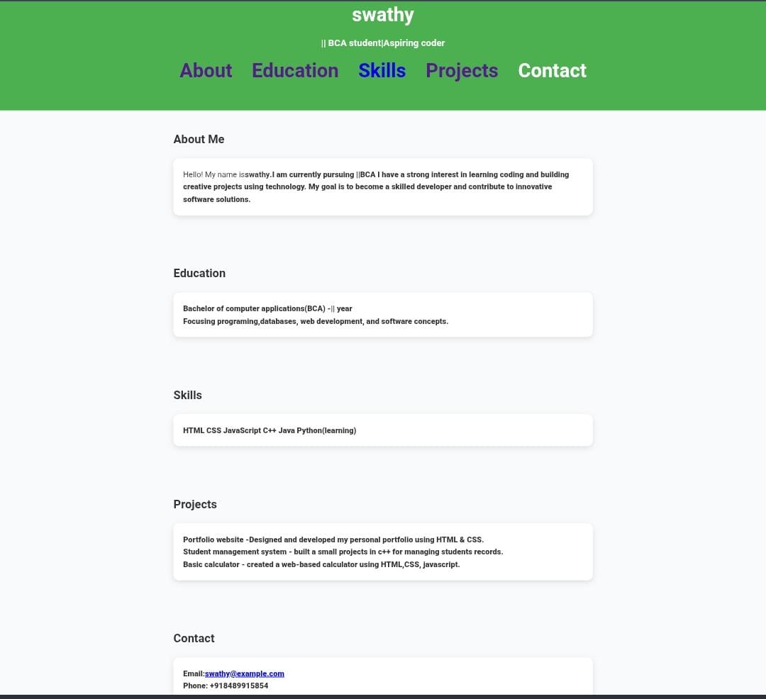
RESULTS AND SCREENSHOTS
Add Screenshots of portfolio project.
Demo Screens.

Slide 11
CONCLUSION
A digital portfolio is an essential tool for professionals and students,offering a dynamic and interactive way to showcase skills.
However,depends on throughful curation and ongoing engagement.

Slide 12
GITHUB LINK
Direct GitHub repository link.
https://github.com/nanmudhalvanTNSDC-FWD-DP/Nanmudhalvan-TNSDC-FWD-DP.git

